Slide 1


Session #1
Introduction
Winter 2025/26

Slide 2
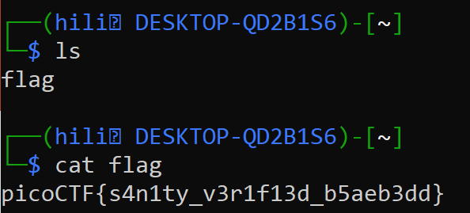
What is CTF?
“Capture The Flag” - Cybersecurity competition
Objective – find "flags" (strings of text) that are hidden in different and creative ways.
Highly technical
01 Introduction

Slide 3
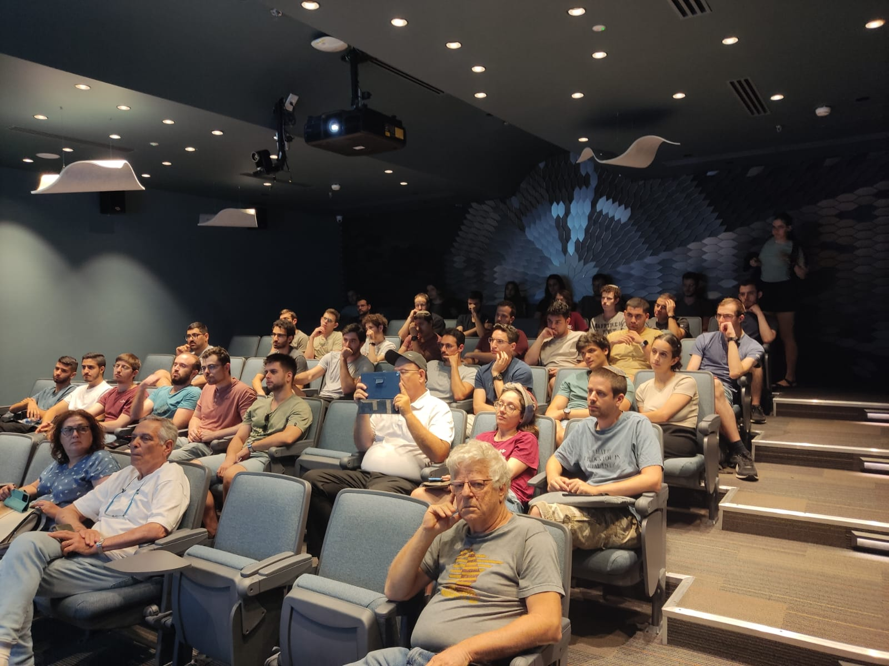

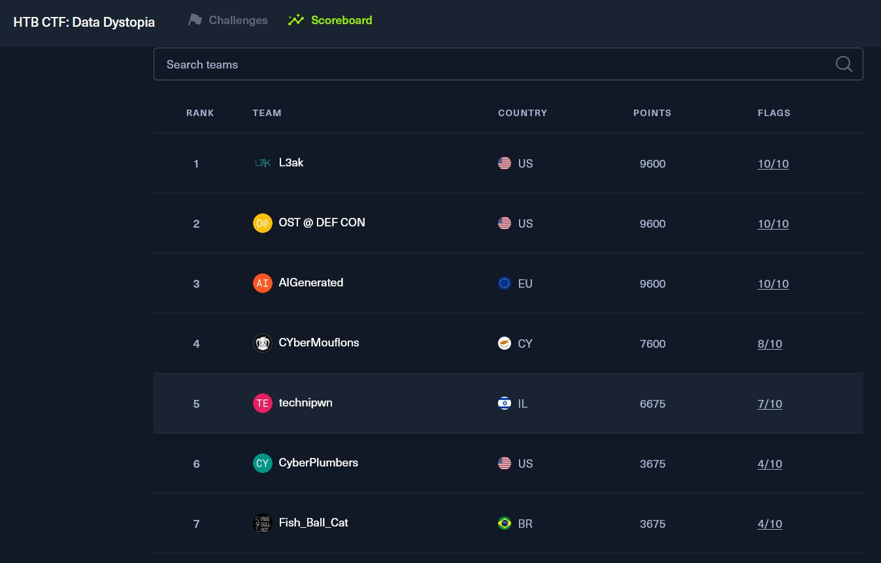
Meeting, Competitions, FUN
01 Introduction

Slide 4


Schedule
10.11 17.11 24.11
29.12
5.1 12.1 26.1
Monday, 18:30-20:00
Competitions
Topics Up Head
  Web
  Prompt Injections
  Reverse Engineering
  Binary exploitation (pwn)
  Guest lectures
  And MORE!
02 Introduction

Slide 5


Website
https://noambenshimon.github.io/technion-ctf/
01 Introduction

Slide 6
Keynote – Prof. Avi Mendelson & Prof. Eli Biham
03 Introduction

Slide 7

Practice Time
Beginners

Slide 8
picoCTF
https://play.picoctf.org/classrooms
  Classroom code: CkQ35rpOI
  Press on 'Practice' -> 'Assignments' -> ‘Introduction'
  Do 'wget' in PicoCTF Webshell if download doesn't work
03 Introduction

Slide 9
Binary search
Problem
  Guess the chosen number
Solution
  Connect to the server via ssh
  Start guessing numbers using binary search
  Success!
03 Introduction

Slide 10
CanYouSee
Problem
  Connect via ssh and find the flag
Solution
  Use exiftool to read meta-data of flag file
  Decode suspicious field 'AttributionURL' from base64
  How did we know it is base64? The field had the char '=', which is common is base64 encodings. It is worth a try.
03 Introduction

Slide 11
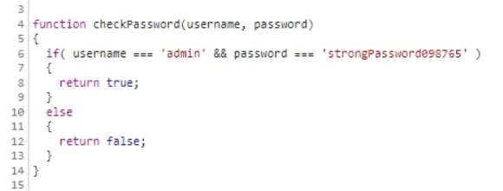
Local Authority
Problem
  Find the flag!
Solution
  The login check is in the browser, and the credentials are being checked there.
03 Introduction

Slide 12
Big Zip
Link to a solution – using grep
https://medium.com/@technolifts/picoctf-big-zip-walkthrough-general-skills-8b44f37d0990
03 Introduction

Slide 13
Super SSH
Link to a solution -
https://medium.com/@technolifts/picoctf-big-zip-walkthrough-general-skills-8b44f37d0990
03 Introduction

Slide 14
Practice Time
Advanced

Slide 15
SansAlpha
Problem: We are given a shell that only accepts characters and numbers, and we need to find a flag file and somehow print it.
Solution: Use bash wildcards (?, *, [], [!]) to gain information about the files and directories in the system, find the flag, and find a way to print it. We try different of ?'s in every directory that we find interesting.
03 Introduction

Slide 16
Operation orchid
Problem: We are given a disk image and our task is to find the flag hidden inside of it.
Solution: Using tools from the SleuthKit collection, we can examine the disk's partitions to find the offset of the relevant partition, copy the encrypted flag file to our machine based on it's inode, and find out the encryption key in the commands history file.
03 Introduction

Slide 17
Next Week...
web exploitation

